Slide 1
Heart Failure: Problem with the ventricle to fill or eject blood
ACC/AHA definition: A complex clinical syndrome that can result from any structural or functional cardiac disorder that impairs the ability of the ventricle to fill with or eject blood
Heart Failure
Right sided
Right atria
Right ventricle
Left sided
Left atria
Left ventricle
Systolic dysfunction
Problem with ejecting
EF < 40%
Diastolic dysfunction
Problem with filling
EF > 40%

Slide 2
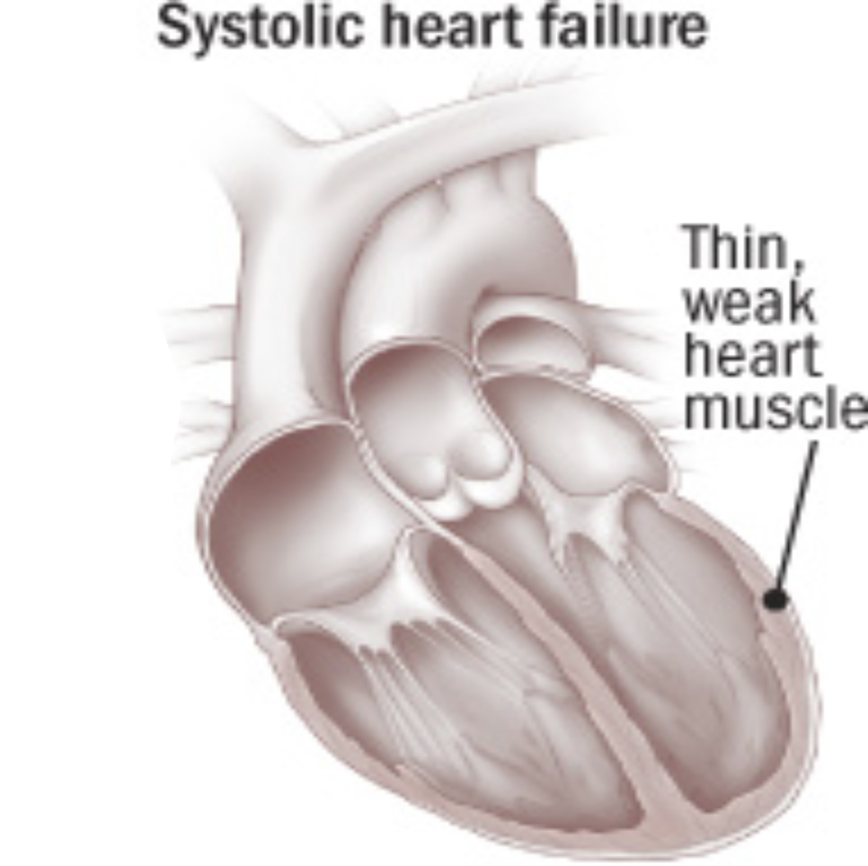
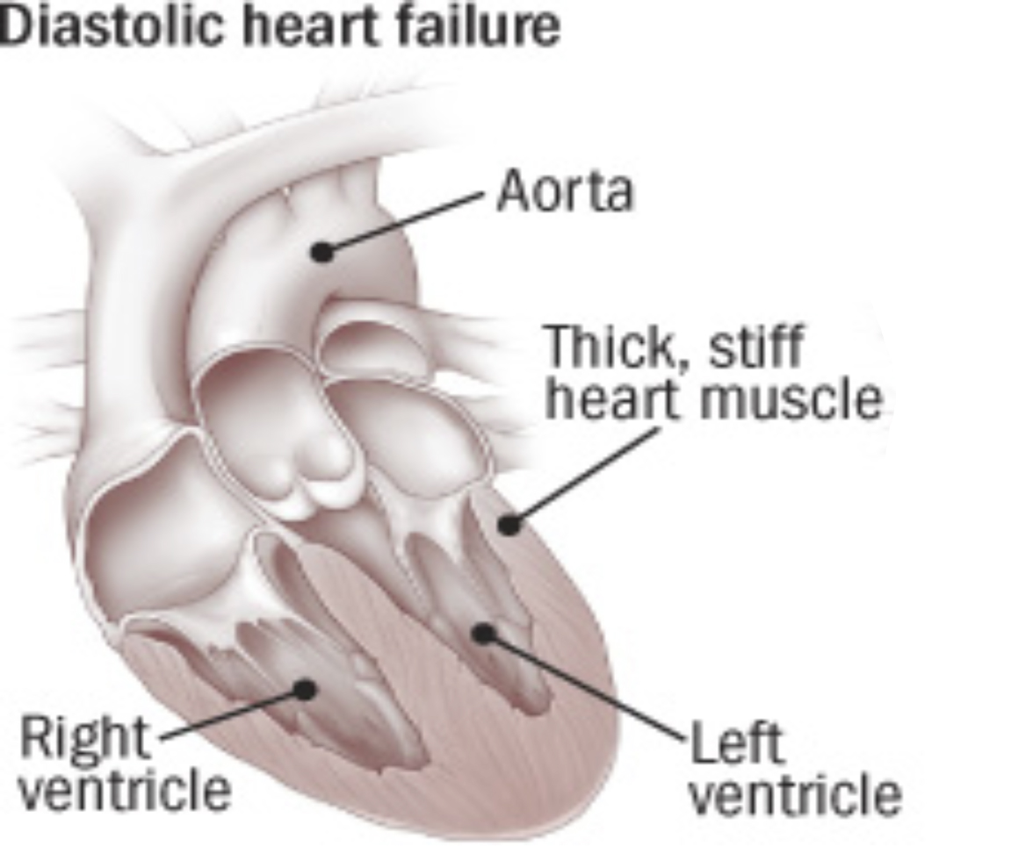
Systolic Dysfunction Vs Diastolic Dysfunction
 | Systolic Dysfunction | Diastolic Dysfunction
Problem with | Ejecting (contracility) | Filling
Cause | CAD Reduced muscle mass Aoritic stent Ischemia | Ventricular stiffness Ventricular hypertrophy (due to HTN) Mitral or tricuspid valve stent
Remodeling Caused by: Angiotensin II NE Aldosterone May led to MI

Slide 3
Diagnosis of HF
Diagnosis | Test | Result
Systolic Dysfunction | Ejection Fraction (EF) | EF < 40%
Diastolic Dysfunction | Ejection Fraction (EF) | EF > 40%
Heart Failure | Natriuretic peptide | High Atrial Natriuretic peptide High BNP High C-type natruretic peptide
Heart Failure | Brain natriuretic peptide | BNP > 100 pg/mL
Natriuretic peptides: a powerful vasodilator, and a protein (polypeptide) hormone secreted by heart muscle cells. It is released by muscle cells in the upper chambers (atria) of the heart (atrial myocytes) in response to high blood pressure.
Brain natriuretic peptide: secreted by the ventricles of the heart in response to excessive stretching of heart muscle cells (cardiomyocytes) net effect of BNP is a decrease in blood volume which lowers systemic blood pressure and afterload, yielding an increase in cardiac output, partly due to a higher ejection fraction.

Slide 4
Diagnosis of HF: Signs and Symptoms
Signs and Symptoms
Lung
Heart
Peripheral
1. rales/crackles
1. S3 gallop (lub, dub, Slosh)
2. Chest X-ray
1. Peripheral edema
2. Jugulo venous distention (JVD)
Vein pops out of neck
3. Hepatojugular reflex (HJR)
press on liver = see fluid in neck
4. Weight gain

Slide 5
Diagnosis of HF: Classification and Staging (don’t have to classify)
 | AHA/ACC Heart Failure Staging
Stage | Description | Example
A | High risk for heart failure, but no structural heart disease or symptoms of heart failure | CAD, obesity, diabetes mellitus, PVD, CVA, family history
B | Structural heart disease is present but without signs and symptoms of heart failure | Prior MI, ↓ LVEF, asymptomatic valvular disease
C | Structural heart disease is present with prior or current symptoms of heart failure | Known structural heart disease and dyspnea, ↓ exercise tolerance
D | Refractory heart failure requiring interventions. (Transplant) | Marked symptoms at rest despite maximal therapy and recurrent hospitalizations
 | NYHA Classification of HF
Class | Description
I | Symptoms only upon levels of exertion that would limit normal individuals
II | Symptoms of HF with ordinary level of exertion
III | Marked limitations in physical activity on less than ordinary exertion (SOB putting on clothes)
IV | Symptoms of HF at rest

Slide 6
Preload
CO = HR * SV
CO = Cardiac Output
HR = Heart Rate
Sympathetic Nervous system affects HR
SV = Stroke Volume contains Preload, afterload and contractility
Preload: Volume of blood before the heart (that the heart will take in)
treat preload: Diuretic to reduce fluid so little volume enters heart
After Load: Volume after the Heart (that the heart has to pump out)
treat afterload: Vasodilate so there’s more room to pump out
Contractility
Afterload
Contractility
Sympathetic

Slide 7
Cause of HF How the heart compensates after HF
Decreased CO
1. Cardiac hypertrophy 2. Activation of SNS 3. ↓ Renal blood flow
↑ Cardiac Contractility
↑ HR, vasoconstriction, shunting of blood to vital organs
RAAS-Activation
↑ O2 demand, ↑ workload
↑ preload, ↑ arrhythmia risk,
↑ myocardial ischemia
↑ O2 demand,↑ cardiac workload,
β1 down regulation, ↓ renal blood flow
Angiotensin II - ↑ afterload
Aldosterone - ↑ preload

Slide 8
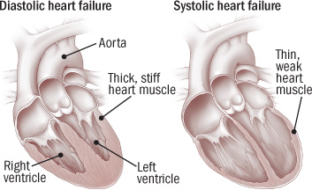
Cause of HF
Cardiac Hypertrophy
Activation of SNS
Decrease Renal Blood flow → RAAS
Cardiac Hypertorphy
Chemicals associated with Cardiac hypertrophy
1. Aldosterone
2. Angiotensin II
3. NE
Chemicals lead to HTN
HTN leads to Ventricular Hypertrophy b/c heart has to pump more
Ventricular Hypertrophy: increase in ventricular muscle mass
Ventricular remodeling: change in size, shape, structure and function of heart
Ventricular remodeling can lead to MI
Angiotensin II
NE
Aldosterone
HTN
Ventricular hypertrophy
Ventricular remodeling
MI

Slide 9
Cause of HF
Cardiac Hypertrophy
Activation of SNS
Decrease Renal Blood flow → RAAS
Activation of SNS → vasoconstriction and increased afterload
Neurohormones:
1. Arginine Vasopressin
2. Angiotensin II
3. NE
Neurohormones vasoconstrictions, redistributing blood flow to coronary and cerebral circulations (important organs)
Neurohormones also increase heart rate, increasing myocardial O2 demand
Increasing O2 demand induces ischemia and worsens diastolic and systolic functions

Slide 10
Cause of HF: Drugs
Drug | Mechanism
NSAIDs | Promote Na⁺ and water retention
Corticosteroids | Promotes Na⁺ and water retention
Antiarrhythmics | Negative inotropic effects Amiodarone and dofetilide (class III) are safe
Non-dihydropyridine CCB (verapamil and diltiazem) | Negative inotropic effects Contraindicated in systolic dysfunction b/c decrease HR
Thiazolidinediones (Actos and Avandia) | Fluid retention Contraindicated in class 3 and 4
Metformin | Increased risk of lactic acidosis can use if patient is stable and can use if CrCl > 1.5 in men can use if CrCl > 1.4 in women
Cilostazol | Inhibition of PDE-3, increases ventricular arrhythmias
Pregabalin | Lower extremity edema

Slide 11
Cause of HF: that increase hospitalizations for HF
Factors that increase hospitalizations for HF | Result
Acute MI | Less O2 = less energy to eject blood
Noncompliance with meds
Uncorrected BP | HTN to V. hypertrophy to remodeling to MI
Pulmonary embolism | Heart can’t pump
Excessive Ethanol | Maybe malnutrition?

Slide 12
Class | DRUG | AFTERLOAD | PRELOAD
 | Goal | Vasodilate & Arteriole | Reduce fluid & Venous
ACE-I | Lisinopril | Decrease | Decrease
ACE-I | Valsartan | Decrease | Decrease
Diuretic | Furosemide |  | Decrease
Diuretic | Sprinorolactone/Eplerenone |  | Decrease
Nitrate | Isosorbide DN |  | Decrease b/c dilate venous (return to heart)
Arteriole Vasodilator | Hydralazine | Decrease b/c dilate arteriole (leave heart)

